Slide 1
BFGS
1
Mohammad Ghaderi
Armin Jodat
Amirhossein Amir Negareshi
Kharazmi University
1402 - 03

Slide 2
introduction
01
2

Slide 3
Limitations of Newton's Method
Computational Complexity: Newton's method requires the computation and inversion of the Hessian matrix, which can be computationally expensive, especially for large-scale optimization problems.
Storage Requirements: In large-scale optimization problems, storing and manipulating the full Hessian matrix can be impractical due to its size.
No Second Derivative Information: The Hessian matrix is crucial in Newton's method because it helps determine the direction and magnitude of the step to take in each iteration. When the Hessian is unavailable or costly to compute, it restricts the applicability of Newton's method. Without the Hessian, Newton's method may struggle in finding the optimal step direction, potentially leading to slower convergence or even divergence.
3

Slide 4
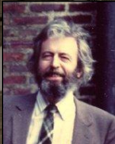
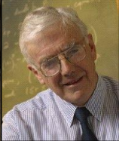
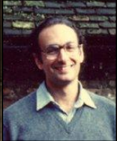

The BFGS quasi Newton method
Broyden-Fletcher-Goldfarb-Shanno
KeyGoal: approximate the Hessian without requiring expensive computation
Keyidea: build the approximation recursively, using curvature information along the generated trajcetory
Charles George Broyden (1933-2011)
Roger Fletcher
(1939-2016)
Donald Goldfarb
(1941-)
David F. Shanno
(1938-)
4

Slide 5
BFGS conditions
1) There is one condition that all quasi-Newton methods must share, and that is the Hessian approximation B must satisfy the quasi-Newton condition (or secant equation)
B_{k+1}​[ x_{k+1​}−x_{k}​ ]=∇f (x_{k+1​})−∇f (x_{k}​) or Bₖ₊₁ Δ x_{k}​ = y_{k}​
2) symmetry and positive-definiteness of B.
3) B_{ᴋ₊₁} to be sufficiently close to Bᴋ at each update k+1. A formal way to characterize the notion of “closeness” for matrices is the matrix norm.
5

Slide 6
BFGS conditions
​min​∥B_{k+1} ​−B_{k}​∥ B_{K+1}
subject to B_{k+1} ^{T​}= B_{k+1}
​and B_{k+1} Δx_{k} = y_{k}​
we recall that it’s actually the Hessian’s inverse, instead of the Hessian itself, that makes an appearance. So instead of computing the approximate Hessian B, we can just as well compute the approximate inverse B⁻¹ directly.
​min​∥ B⁻¹_{k+1} ​−B⁻¹_{k}​∥ B⁻¹_{K+1}
subject to B⁻¹_{k+1} ^{T​}= B⁻¹_{k+1}
​and B⁻¹_{k+1} Δx_{k} = y_{k}​
6

Slide 7
BFGS conditions
To solve for B_{k+1}, we still have to specify the particular matrix norm we’re using in. Different choices of norms result in different quasi-Newton methods. In the BFGS method, the norm is chosen to be the Frobenius norm
it suffices to know that the problem ends up being equivalent to updating our approximate Hessian at each iteration by adding two symmetric, rank-one matrices U and V:
B_{k+1 =} B_{k} + U_{k} + V_{k}
7

Slide 8
BFGS conditions
To fulfill the aforementioned conditions, the update matrices can then be chosen to be of the form U = a u uᵀ and V = b v vᵀ, where u and v are linearly independent non-zero vectors, and a and b are constants. The outer product of any two non-zero vectors is always rank one, and since U and V are both the outer product of a vector with itself, they are also symmetric, taking care of the requirement that the Hessian remains symmetric upon updates:
B_{k+1 =} B_{k} + auuᵀ + bvvᵀ
8

Slide 9

BFGS conditions
Furthermore, we have to impose the quasi-Newton condition B_{ᴋ+1}Δx = y_{ᴋ} :
B_{k+1}​Δx_{k​}=B_{k​}Δx_{k​}+auu^{T}Δx_{k​}+bvv^{T}Δx_{k​}=y_{k​}
u = y_{ᴋ}
v = B_{ᴋ} Δx_{ᴋ}
a= $\frac{1}{\text{y}\text{ₖᵀ}\text{Δ}\text{x}\text{k}\text{​}}$
b = - $\frac{\text{1}}{\text{Δ}\text{x}\text{k}\text{ᵀ}\text{B}\text{k}\text{Δ}\text{x}\text{k}}$
B_{k+1} $=\text{B}\text{k} \text{+}\frac{\text{(}\text{y}\text{ₖ }\text{y}\text{ₖᵀ)}}{\text{(}\text{y}\text{ₖᵀ }\text{s}\text{ₖ)}}$ - $\frac{\text{(}\text{B}\text{ₖ }\text{s}\text{ₖ }\text{s}\text{ₖᵀ }\text{B}\text{ₖ)}}{\text{(}\text{s}\text{ₖᵀ }\text{B}\text{ₖ }\text{s}\text{ₖ)}}$
9

Slide 10
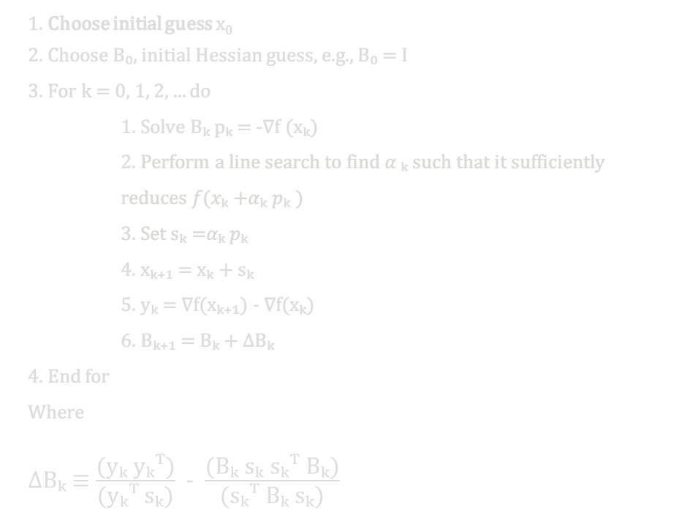
The BFGS Algorithm
1. Choose initial guess x₀
2. Choose B₀, initial Hessian guess, e.g., B₀ = I
3. For k = 0, 1, 2, ... do
1. Solve Bₖ pₖ = -∇f (xₖ)
2. Perform a line search to find 𝛼 ₖ​ such that it sufficiently reduces 𝑓(𝑥ₖ +𝛼ₖ 𝑝ₖ )
3. Set sₖ =𝛼ₖ 𝑝ₖ
4. xₖ₊₁ = xₖ + sₖ
5. yₖ = ∇f(xₖ₊₁) - ∇f(xₖ)
6. Bₖ₊₁ = Bₖ + ΔBₖ
4. End for
Where ΔBₖ ≡ $\frac{\text{(}\text{y}\text{ₖ }\text{y}\text{ₖᵀ)}}{\text{(}\text{y}\text{ₖᵀ }\text{s}\text{ₖ)}}$ - $\frac{\text{(}\text{B}\text{ₖ }\text{s}\text{ₖ }\text{s}\text{ₖᵀ }\text{B}\text{ₖ)}}{\text{(}\text{s}\text{ₖᵀ }\text{B}\text{ₖ }\text{s}\text{ₖ)}}$
10

Slide 11
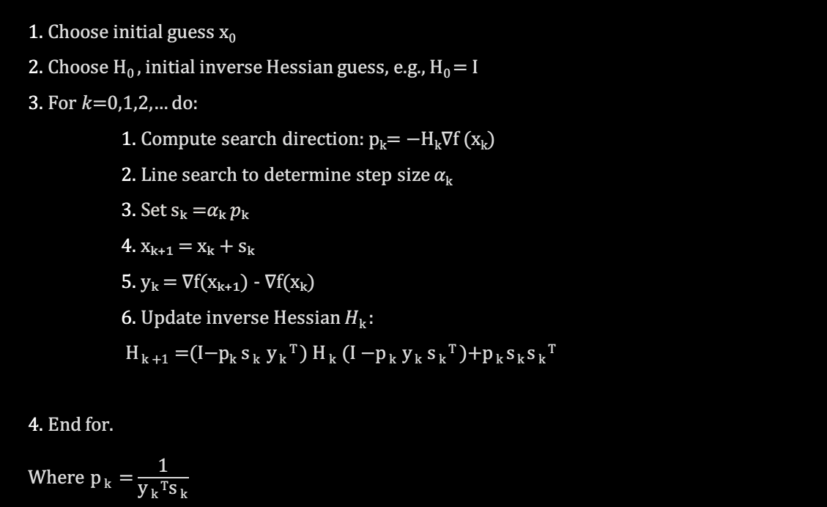
The modified BFGS algorithm
1. Choose initial guess x₀
2. Choose H₀ ​, initial inverse Hessian guess, e.g., H₀ = I
3. For 𝑘=0,1,2,… do:
1. Compute search direction: p_{k}​= −H_{k}​​∇f (x_{k}​​)
2. Line search to determine step size 𝛼_{k}​
3. Set sₖ =𝛼ₖ 𝑝ₖ
4. xₖ₊₁ = xₖ + sₖ
5. yₖ = ∇f(xₖ₊₁) - ∇f(xₖ)
6. Update inverse Hessian 𝐻_{k} ​:
H _{k +1} ​=(I−p_{k}​​ s _{k} ​ y _{k} ^{T} ​) H _{k} ​(I −p _{k} ​y _{k} ​s _{k} ^{T} ​)+p _{k} ​s _{k} ​s _{k} ^{T}
4. End for. Where p _{k} ​ = $\frac{\text{1}}{\text{y} \text{k} \text{T}\text{s} \text{k}\text{ ​}}$
11

Slide 12
comparison
02
Comparison with other algorithms
12

Slide 13
ALGORITHMS TO COMPARE
STEEPEST DESCENT
NEWTOS’S METHOD
CONJUGATE GRADIANT(CG)
LIMITED-MEMORY BFGS
13

Slide 14
Steepest descent vs BFGS
Algorithm Steps:
1. Start with an initial guess x0​.
2.Compute the gradient ∇𝑓(𝑥𝑘).
3.Update the current point: 𝑥𝑘+1=𝑥𝑘−𝛼𝑘∇𝑓(𝑥𝑘) where 𝛼𝑘 is the step size.
4.Repeat until convergence criteria are met (e.g., the gradient norm is below a threshold).
You can write about a concept here and talk about it a little
Also known as Gradient Descent, this method iteratively moves towards the minimum of a function by taking steps proportional to the negative of the gradient (steepest descent direction)
14

Slide 15
Steepest descent vs BFGS
Steepest desccent:
BFGS:
Uses the gradiant direction for update
Pros: simple, easy to implement
Cons: Slow convergence, especially for ill-conditioned problems
Uses gradient and Hessian proximation
Pros: Faster convergence than steepest descent, handles ill-conditioned problems better.
Cons: More complex, requires more memory.
15

Slide 16

Newton's Method vs BFGS
Algorithm Steps:
1. Start with an initial guess x0​.
2.Compute the gradient ∇𝑓(𝑥𝑘) and the Hessian 𝐻(𝑥𝑘).
3.Update the current point:
4.Repeat until convergence criteria are met (e.g., the gradient norm is below a threshold).
Uses both first and second-order derivatives (the gradient and the Hessian) to find the minimum of a function.
16

Slide 17
Newton's Method vs BFGS
Newton's Method :
BFGS :
Uses exact Hessian matrix.
Pros: Quadratic convergence, very fast for well-conditioned problems.
Cons: Requires computation of Hessian, expensive for large problems
Uses approximate Hessian.
Pros: Avoids explicit Hessian computation, less memory-intensive..
Cons: Slower than Newton’s method for very well-conditioned problems.
17

Slide 18
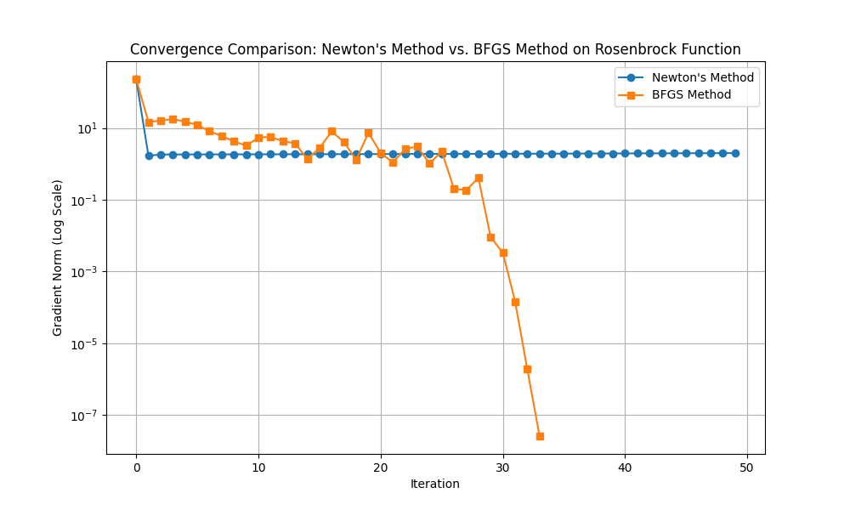
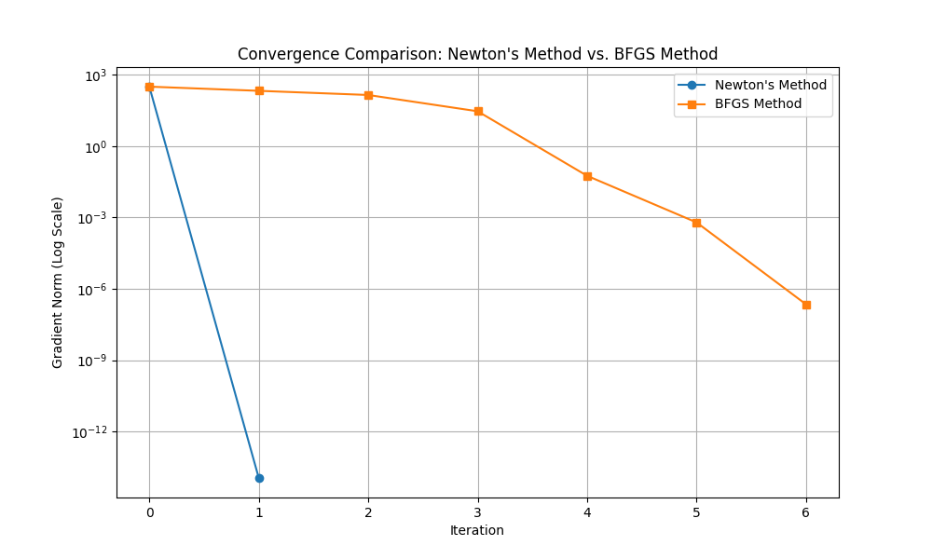
ill– conditioned
well - conditioned
18

Slide 19
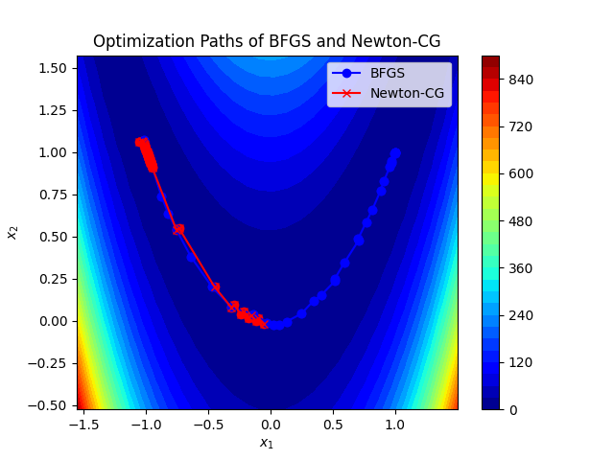
Optimal solution (BFGS): [0.99999997 0.99999995]
Optimal solution (Newton): [-0.05223799 -0.01680011]
18

Slide 20
Conjugate Gradient vs BFGS
Algorithm Steps:
1. Start with an initial guess x0​.
2. Compute the initial gradient and set the initial direction.
3. Iterate, adjusting the direction to be conjugate to previous directions.
4. Update the current point along the new direction.
5.Repeat until convergence criteria are met
An iterative method for solving large-scale linear systems, particularly useful for sparse systems. Can also be adapted for nonlinear optimization
19

Slide 21
Conjugate Gradient vs BFGS
Conjugate Gradient:
BFGS:
Suitable for large-scale, sparse problems.
Pros: Memory efficient, good for large dimensions.
Cons: Requires good preconditioning, slower without it.
Better for dense problems.
Pros: More robust without preconditioning, better for medium-sized problems.
Cons: More memory than CG.
20

Slide 22
L-BFGS vs BFGS
Algorithm Steps:
1. Start with an initial guess x0​ and an initial Hessian approximation (often identity matrix).
2. Compute the gradient and update the point.
3. Maintain a limited history of updates to approximate the Hessian.
4 Update the current point using this limited history.
5. Repeat until convergence criteria are met
A variant of BFGS that uses a limited amount of memory by storing only a few vectors that represent the approximation to the Hessian
21

Slide 23
L-BFGS vs BFGS
L-BFGS (Limited-memory BFGS):
BFGS:
Uses limited memory to approximate Hessian.
Pros: Suitable for very large-scale problems, reduced memory requirements.
Cons: May require more iterations than full BFGS.
Uses full memory for Hessian approximation.
Pros: Generally fewer iterations than L-BFGS, more accurate updates.
Higher memory usage.
22

Slide 24
When to Use BFGS
Medium to large-scale optimization problems.
Problems where Hessian computation is impractical.
Scenarios where gradient-based methods are too slow.
23

Slide 25
Conclusion and Summary
BFGS strikes a balance between steepest descent and Newton’s method
Offers a practical approach for many optimization problems.
Choice of algorithm depends on problem size, condition, and resource availability
24

Slide 26
Test problems
03
25

Slide 27

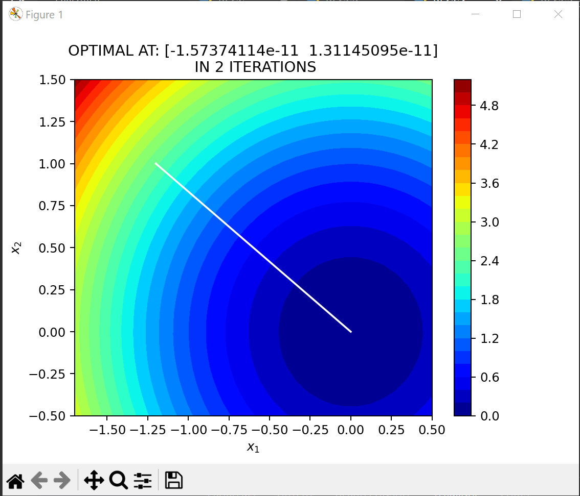

Test problem for BFGS
Sphere function
26

Slide 28
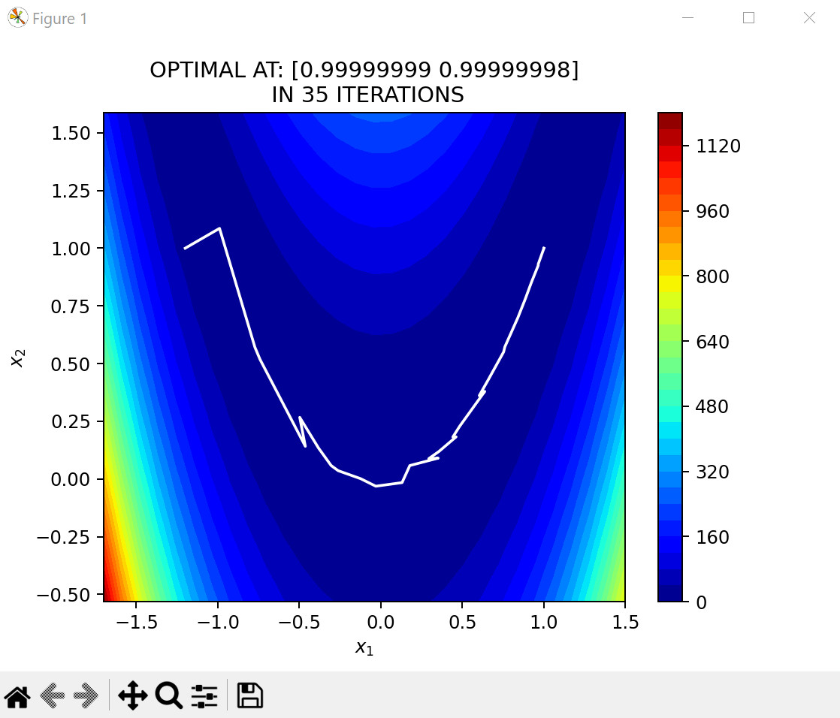

Test problem for BFGS
rosenbrok function
27

Slide 29
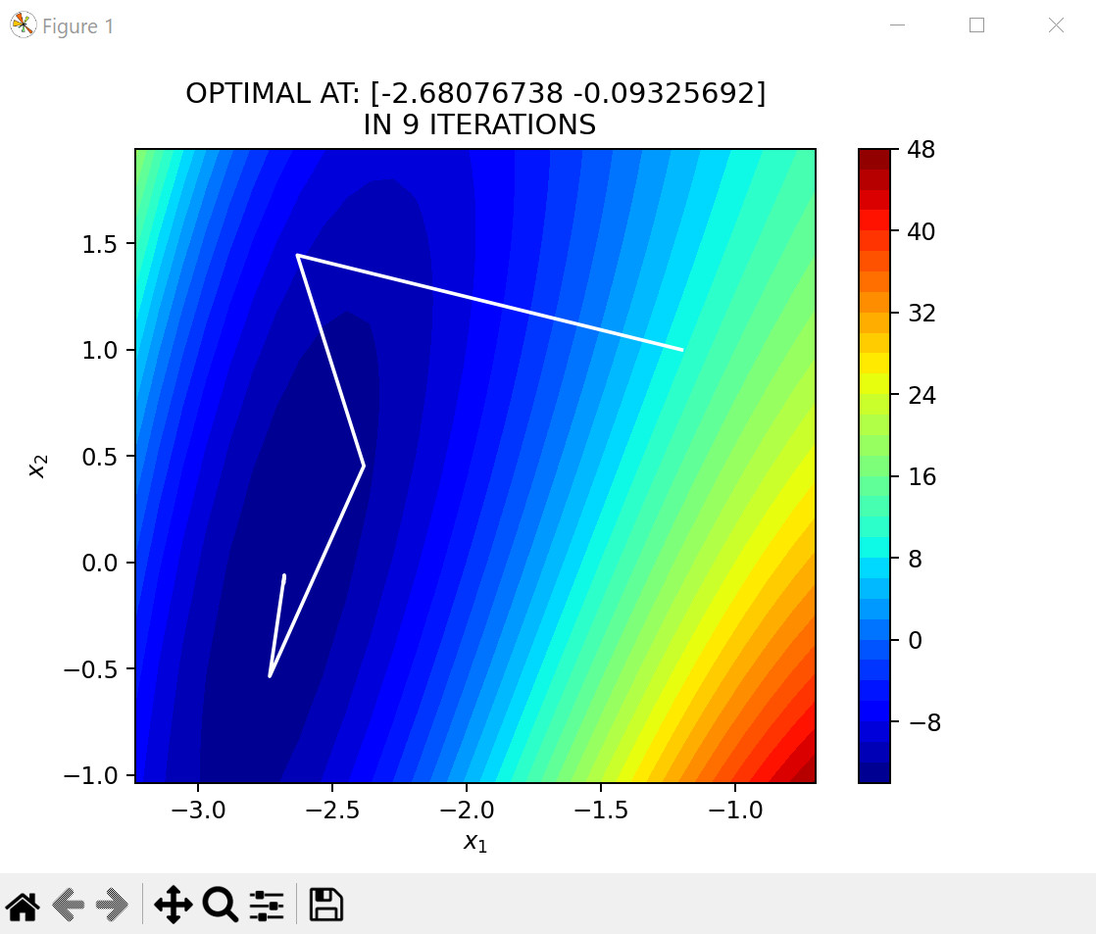
Test problem for BFGS
himmelblu function
28

Slide 30
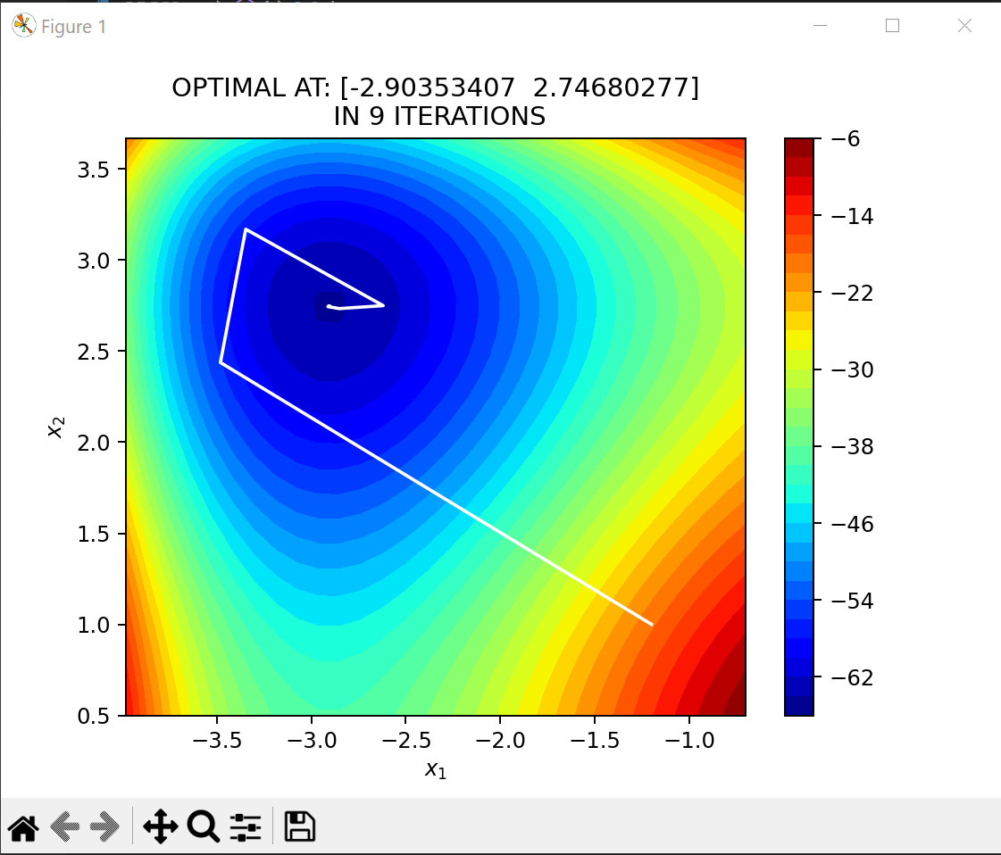

Test problem for BFGS
Styblinski–Tang function
29

Slide 31
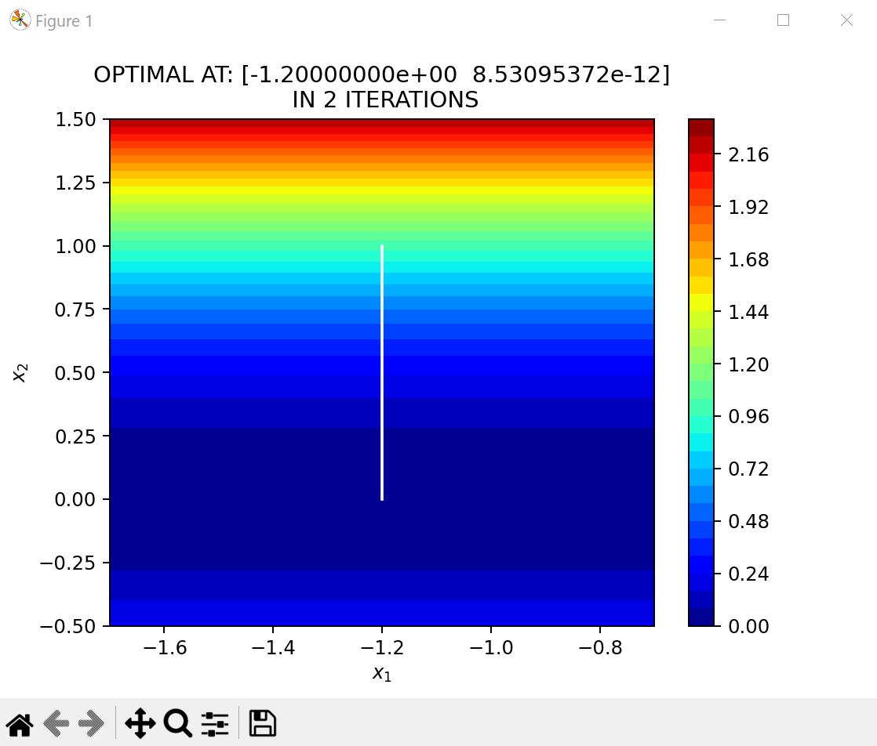

Test problem for BFGS
Sumsqure function
29

Slide 32
resources
https://wwwsop.inria.fr/coprin/logiciels/ALIAS/Benches/node6.html
http://ukm.my/jsm/pdf_files/SM-PDF-43-10-2014/17 Mohd Asrul.pdf
https://machinelearningmastery.com/bfgs-optimization-in-python/
https://github.com/trsav/bfgs
https://youtu.be/mRo-NUGYZ9w?si=7KnPGBeCHS5hNS3T
https://www.aparat.com/v/Dir2B
30

